Slide 1
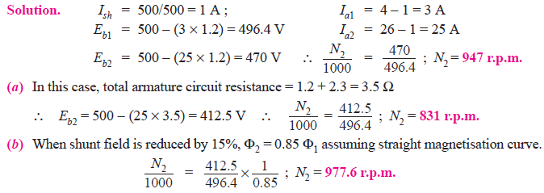
Example-1
A 500 V d.c. shunt motor has armature and field resistances of 1.2 Ω and 500 Ω respectively. When running on no-load, the current taken is 4 A and the speed is 1000 r.p.m. Calculate the speed when motor is fully loaded and the total current drawn from the supply is 26 A. Estimate the speed at this load if (a) a resistance of 2.3 Ω is connected in series with the armature and (b) the shunt field current is reduced by 15%.

Slide 2
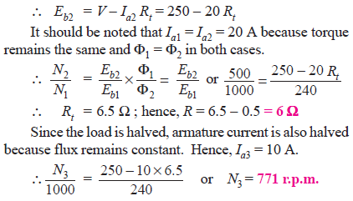
Example-2
A 250-V shunt motor has an armature current of 20 A when running at 1000 r.p.m. against full load torque. The armature resistance is 0.5 Ω. What resistance must be inserted in series with the armature to reduce the speed to 500 r.p.m. at the same torque and what will be the speed if the load torque is halved with this resistance in the circuit ? Assume the flux to remain constant throughout and neglect brush contact drop.

Slide 3
Example-2
A 250-V shunt motor (Fig. 30.6) has an armature current of 20 A when running at 1000 r.p.m. against full load torque. The armature resistance is 0.5 Ω. What resistance must be inserted in series with the armature to reduce the speed to 500 r.p.m. at the same torque and what will be the speed if the load torque is halved with this resistance in the circuit ? Assume the flux to remain constant throughout and neglect brush contact drop.

Slide 4
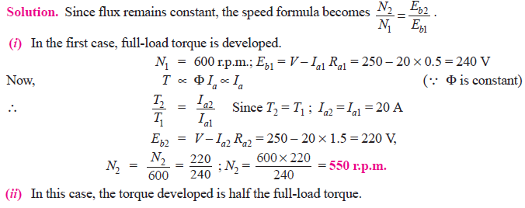
Example-3
A 250-V shunt motor with armature resistance of 0.5 ohm runs at 600 r.p.m. on full-load and takes an armature current of 20 A. If resistance of 1.0 ohm is placed in the armature circuit, find the speed at (i) full-load torque (ii) half full-load torque.

Slide 5

Example-3
A 250-V shunt motor with armature resistance of 0.5 ohm runs at 600 r.p.m. on full-load and takes an armature current of 20 A. If resistance of 1.0 ohm is placed in the armature circuit, find the speed at (i) full-load torque (ii) half full-load torque.

Slide 6
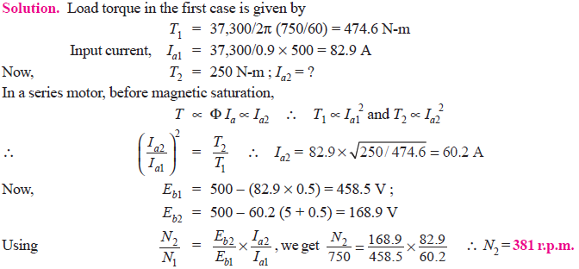
Example-4
The speed of a 50 h.p (37.3 kW) series motor working on 500 V supply is 750 r.p.m. at full-load and 90 per cent efficiency. If the load torque is made 350 N-m and a 5 ohm resistance is connected in series with the machine, calculate the speed at which the machine will run. Assume the magnetic circuit to be unsaturated and the armature and field resistance to be 0.5 ohm.

Slide 7
Example-4
The speed of a 50 h.p (37.3 kW) series motor working on 500 V supply is 750 r.p.m. at full-load and 90 per cent efficiency. If the load torque is made 350 N-m and a 5 ohm resistance is connected in series with the machine, calculate the speed at which the machine will run. Assume the magnetic circuit to be unsaturated and the armature and field resistance to be 0.5 ohm.

Slide 8
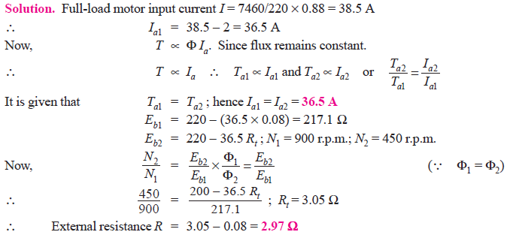
Example-5
A 7.46 kW, 220 V, 900 r.p.m. shunt motor has a full-load efficiency of 88 percent, an armature resistance of 0.08 Ω and shunt field current of 2 A. If the speed of this motor is reduced to 450 r.p.m. by inserting a resistance in the armature circuit, the load torque remaining constant, find the motor output, the armature current, the external resistance and the overall efficiency.

Slide 9
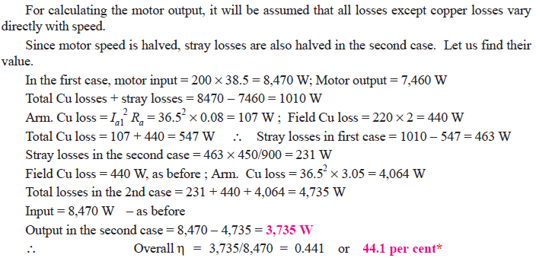
Example-5

Slide 10
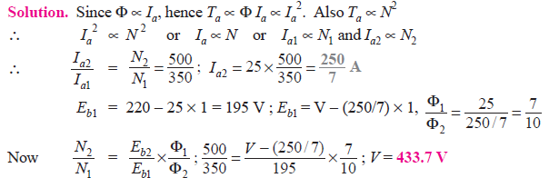
Example-6
A d.c. series motor having a resistance of 1 Ω drives a fan for which the torque varies as the square of the speed. At 220 V, the set runs at 350 r.p.m. and takes 25 A. The speed is to be raised to 500 r.p.m. by increasing the voltage. Determine the necessary voltage and the corresponding current assuming the field to be unsaturated.

Slide 11
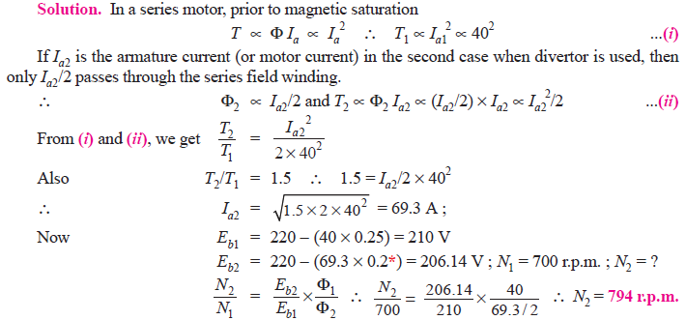
Example-7
A 200 V, d.c. series motor takes 40 A when running at 700 r.p.m. Calculate the speed at which the motor will run and the current taken from the supply if the field is shunted by a resistance equal to the field resistance and the load torque is increased by 50%.
Armature resistance = 0.15 Ω, field resistance = 0.1 Ω
It may be assumed that flux per pole is proportional to the field.

